Slide 1
Final Mini Project Demonstration
UE17CS356E
Project Title : Multimodal navigation for autonomous Drones
Project ID : MPW20KSS02
Project Guide : Prof. K S Srinivas
Project Team : Pruthvish E PES1201701629
Vishwas N S PES1201701321

Slide 2
Project Abstract and Scope
Abstract:-
Drones have versatile use cases from doorstep delivery to finding witnesses in crime scenes. Making the complete working of the drones autonomous is the problem at hand , autonomously making optimal decisions by taking actions based on the state of the surroundings , while decisions differ from state to state and from one surrounding to another, we can broadly classify the surroundings has external and internal which covers most types of surroundings , and agents way of learning is different in this type of surroundings and the transition from one surrounding to another is rather a complex task to make it completely autonomous , in this paper we have implemented ways to autonomously traverse in this surroundings and make suitable transitions from one surrounding to another optimally using reinforcement learning and other deep learning routines.
Scope:-
To implement separately the outdoor and indoor autonomous navigation of the drone in various simulated environments and to find the perfect transition point or the term we coin as the delicacy point where the drone switches from one transition mode to another.
To attain better accuracy and to generate optimal paths for navigation and to explore the environment with minimum collisions or crashes.

Slide 3
Design Approach
Indoor
Outdoor
ROS
gazebo
RVIZ
octomap
Move_base
To map indoor environment and navigate through it.
Reinforcement learning
DQN
Frames(camera and other sensors data)
Deep neural networks
To plan and navigate in the External environment.
Mode shift
Train Data
Localisation
To shift modes

Slide 4
Design Constraints, Assumptions & Dependencies
Dependencies:-
We will be using Robot Operating System (ROS) for communication and Gazebo for simulation. We plan to use the libraries octomap for mapping and move_base for navigation and for outdoor navigation we will be using cntk , keras and tensorflow and pytorch and DQN with mask RCNNs to train the model.
Assumptions:-
Simulation of our surroundings almost resembles with the real time environment. It is unlikely there is a new event which is not taken care in our training period.
Problems:-
Hardware for the Implementation of the robot costs a lot.
So we will be running a simulation of the robot.

Slide 5
Design Description/UI Design
User Interface
Provide end point details
Track location of robot
Retrieve / Load map of a particular environment
Planning
Obstacle detection and avoidance
Creation of global and local plans
Switching between different navigation modes
Robot Control
Actuation and Balance
Sensor interface and data acquisition
Image processing / Stereo Vision

Slide 6
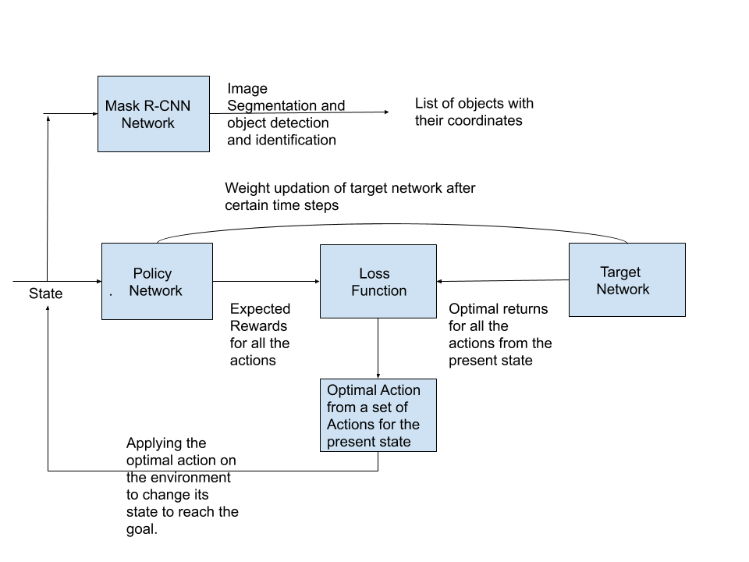
Design Description/UI Design
Outdoor Navigation

Slide 7
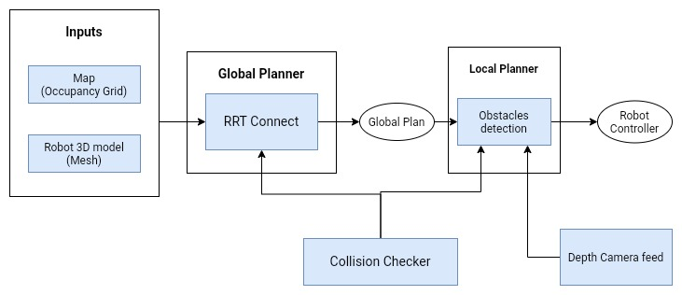
Design Description/UI Design
Indoor Navigation

Slide 8
Design Description/UI Design
Implementation of the actual Drone
Stereo Camera
IMU
Depth Image
Orientation
Acceleration
Raspberry PI
Velocity
Arduino
Position Estimation
ROS
Sensor Reading
Map Generation
Sensor Data
Control Loop
Planner
Speed
Motors

Slide 9
Technologies Used
Robot Operating System - ROS : Interface to implement the bot
Gazebo simulator : To simulate indoor environment
RVIZ : 3D visualisation tool
Reinforcement Learning - DQN : to train the drone
CNTK : libraries to train
Keras : libraries to train
Tensorflow : libraries to train
pytorch : libraries to train
airsim : To Simulate the Outdoor environment
gmapping/octomap : To map the environment for future planning
move_base : To take action on the drone
Mask R-CNNs : For object detection and identification
Notes:
‹#›

Slide 10
Project Progress So far
We have implemented the outdoor and indoor navigation of the drone, We have used an experimental probabilistic approach to find the delicacy point considering the pv tradeoff for the pv modes and switch optimality ratio for now.
We have completed 85% of the project.
Notes:
‹#›

Slide 11
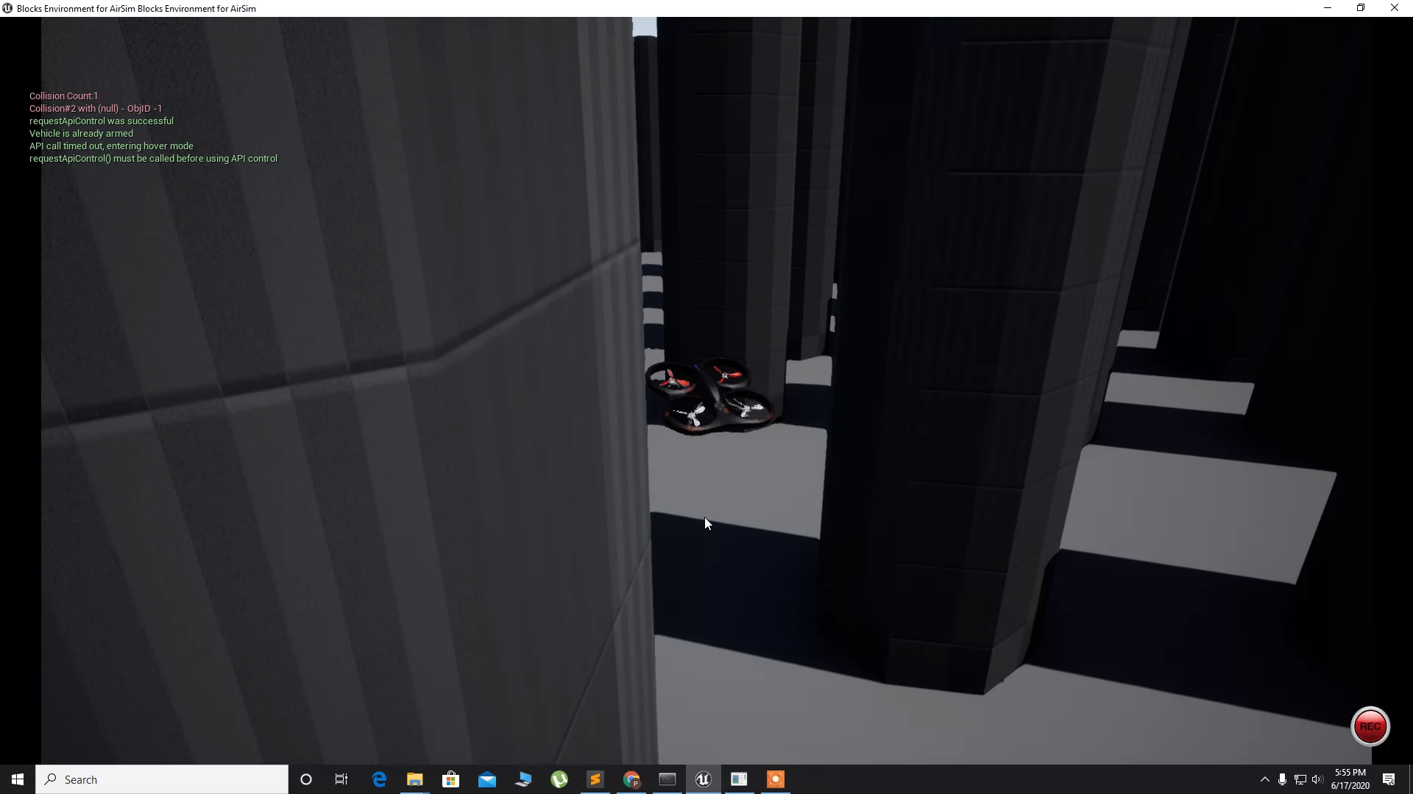
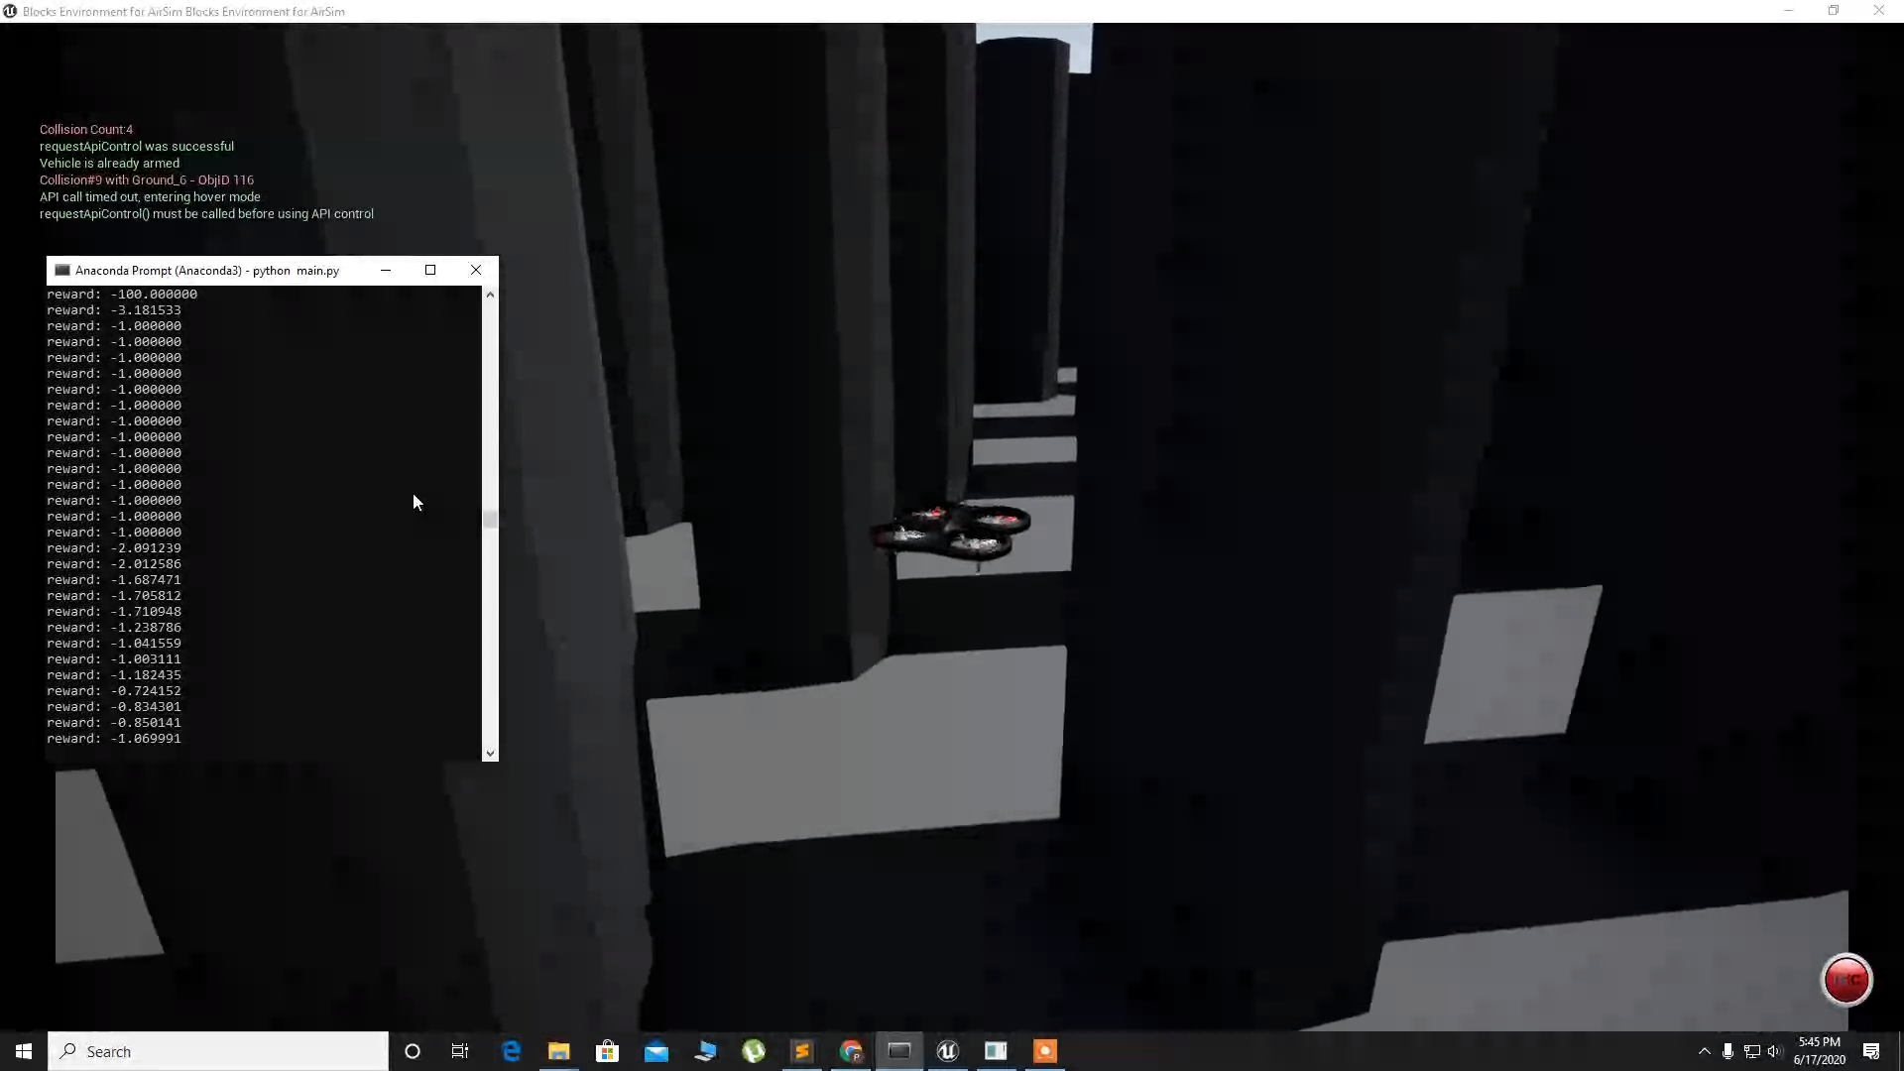
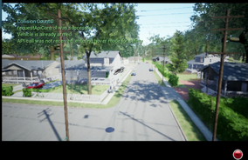
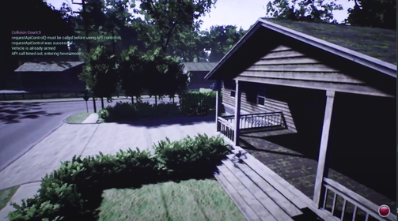
Project Demo
Notes:
‹#›

Slide 12
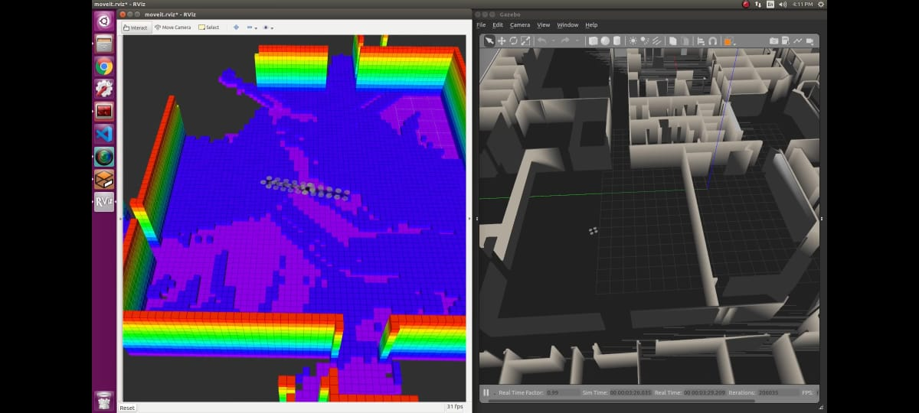
Project Demo
Notes:
‹#›

Slide 13
Project Demo
Link To demo videos:-
https://drive.google.com/drive/folders/1_fcaNd86MDIWr3D04ZFKa7g7plzc0gGA?usp=sharing
Notes:
‹#›

Slide 14
Thank You

